Slide 1
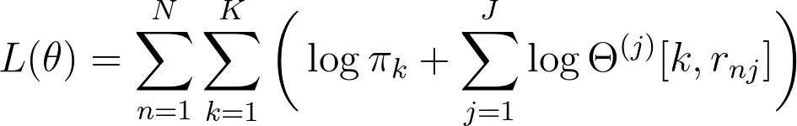

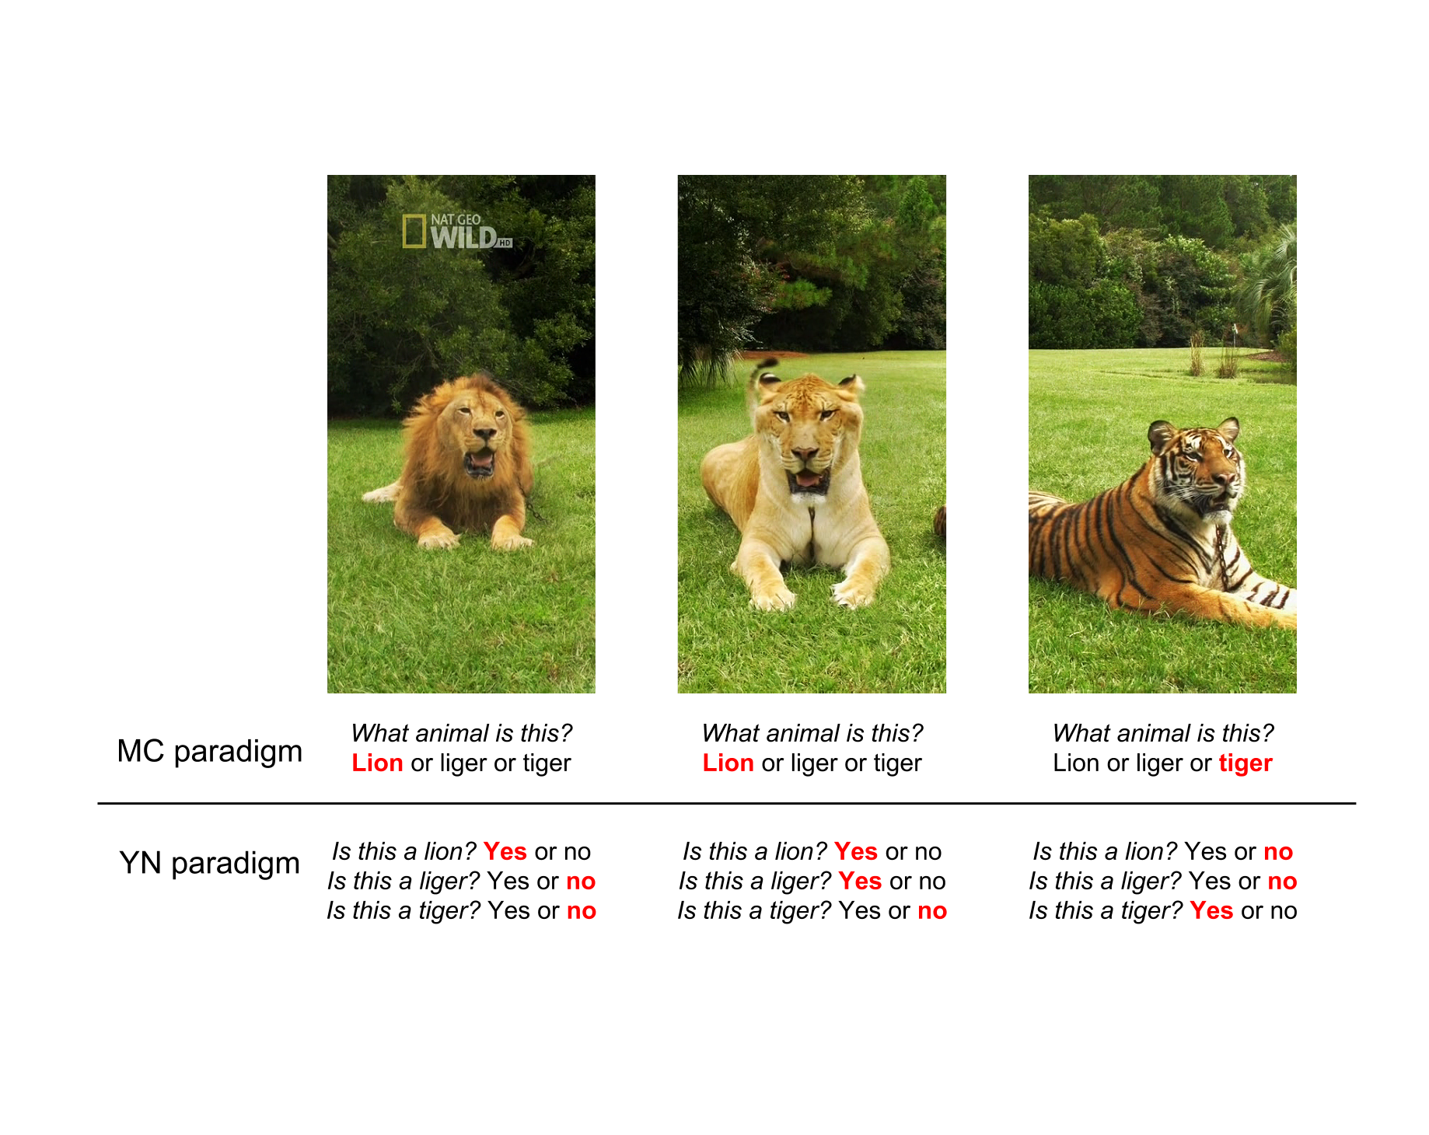
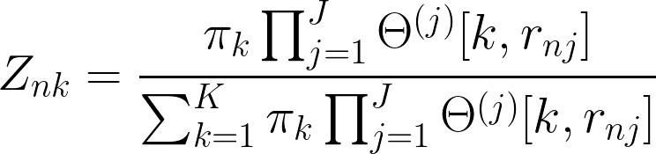
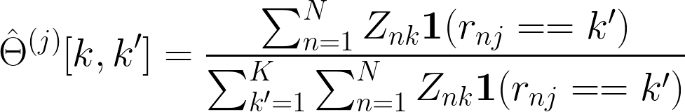
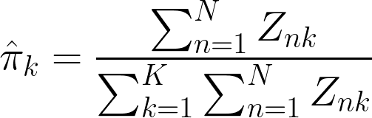
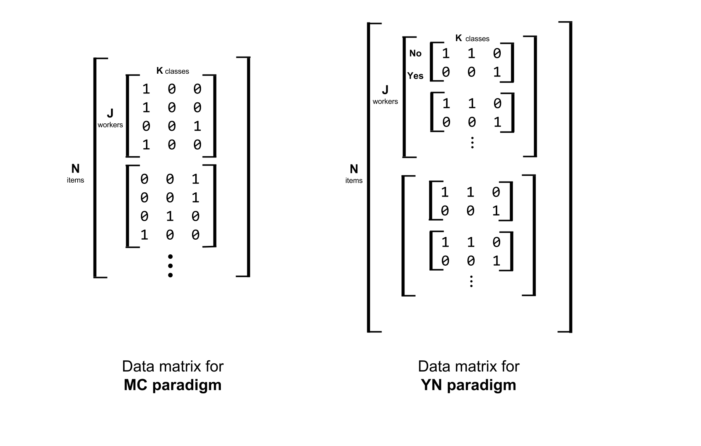

Exploration of Questioning Strategies for Crowdsourced Labeling
Neil Chainani, Christian Junge, Abhishek Malali
AM 207 Spring 2016
Introduction
In this project, we contrast two different questioning schemes to assess efficacy in recovering true class labels from noisy labels provided by crowdsourced nonexperts, when there are more than two classes to choose from. We generate data with a confusion matrix for each expert, and an underlying class distribution, and attempt to recover both parameters and the true labels. We use Expectation Maximization (EM), Simulated Annealing, and PyMC to compare efficiency and verify results.
Having reliable labeled data is crucial for any supervised learning task. But given large datasets, manually determining these labels may be intractable. Services like Mechanical Turk can be particularly useful to crowdsource labeling, but it is difficult to guarantee that the workers will reputably provide correct labels, so often the study will aggregate labeling on a particular item from multiple workers.
The task becomes even more difficult with more classes from which to choose, or ambiguity between classes. Take the classic example of lions, tigers, and ligers. An image of a liger may fall closer to a tiger on the lion-tiger spectrum, and thus be hard to classify.
We compare the standard multiclass paradigm (MC), where the worker is presented with an image and has to select a single class, with the Yes-No paradigm (YN), where the worker is presented with the same image K times, is asked "Is this image of class k?", and must answer yes or no.
Approach
Results
The complete data log likelihood for the MC case is derived to be:
And for the YN case:
From here, we first pursued two methods to recover the true class labels:
Expectation Maximization:
The E-step in the MC case is:
And the M-step to update our estimates of the confusion matrices and class distributions are:
We alternate between E and M until convergence.
Simulated Annealing:
For SA, our states are represented by our estimate of the labels. We initially randomly assign labels to each item, and then reassign labels for a random item. We calculate the likelihood on the set of estimated labels, and determine the confusion matrices based on the counts.
We used two data sets: an easy data set and a hard data set. Both have 5 workers and 4 classes, but the difference is in the confusion matrices. The easy data have confusion matrices close to an identity matrix, while the hard confusion matrices are much more muddled. We compared accuracy (the percentage of predicted labels that match the true labels) for 40, 80, 100, 200, and 500 data points, on both the easy and hard data. For EM, we also looked how having a single confusion matrix shared between all workers impacted our results.
Figure 1. Imagine a worker is faced with these three images. They may classify the images of tigers and lions correctly, regardless of the questioning strategy. However, we postulate that their answer with the YN paradigm will allow us to more accurately recover the true class of the liger.
Data Generation
For both strategies, we begin with a unique confusion matrix of size K × K per worker, and we predetermine the true class labels for each item. Then, for the MC case, we use a one-hot vector to represent which class a worker picked on a particular item. For the YN strategy, we use a one-hot vector to denote whether they answered yes or no for each class on the item.
Conclusions
Citations and Links
The conclusion that we draw from the results is that the YN paradigm is better suited for scenarios where the confusion matrix for the worker is poor; that is, when the diagonal of the confusion matrix isn't as heavily weighted. This aligns with our results from our PyMC simulations. The drawback though comes in the form of computation – the number of questions increases linearly with increasing number of classes. Regardless of the method or difficultly of data set, our accuracy was not correlated with an increase in data points.
C.Liu and Y.M.Wang, TrueLabel + Confusions: A Spectrum of Probabilistic Models in Analyzing Multiple Ratings, Proceedings of the 29th International Conference on Machine Learning(ICML-12)
A.P.Dawid and A.M.Skene, Maximum Likelihood Estimation of Observer Error-Rates using EM Algorithm, Journal of the Royal Statistical Society: Series C (Applied Statistics), Vol. 28, No. 1(1979), pp. 20-28
School of Engineering and Applied Sciences • Institute for Applied Computational Science

